Slide 1
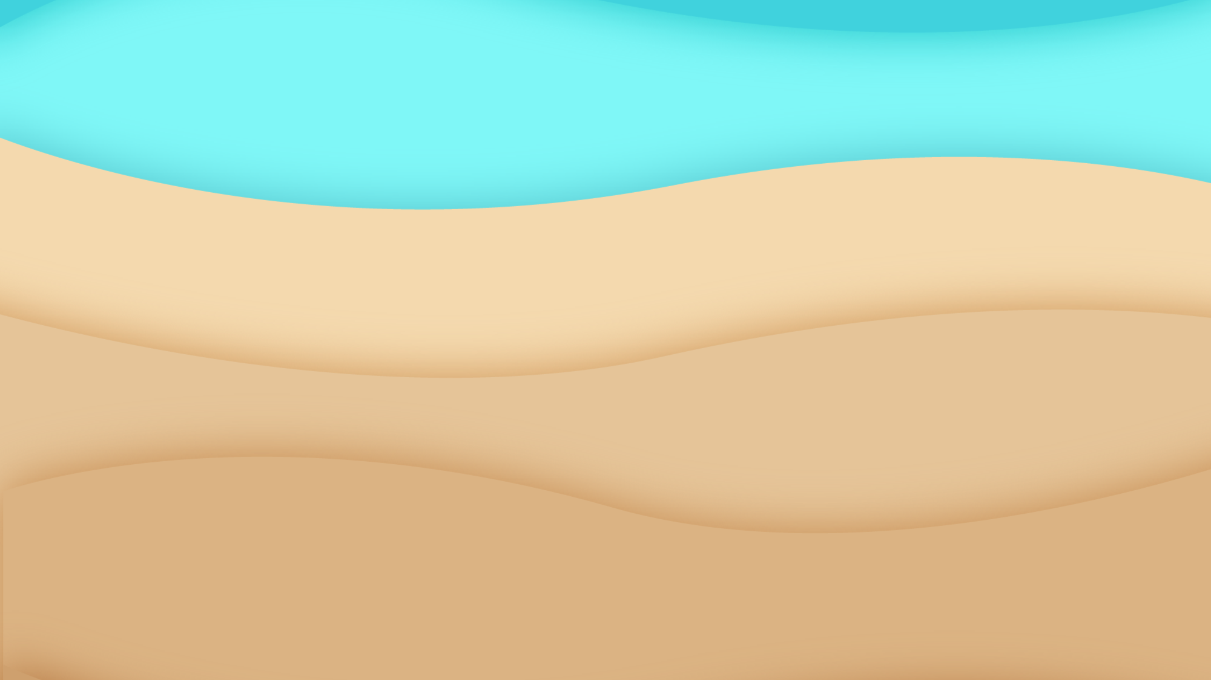
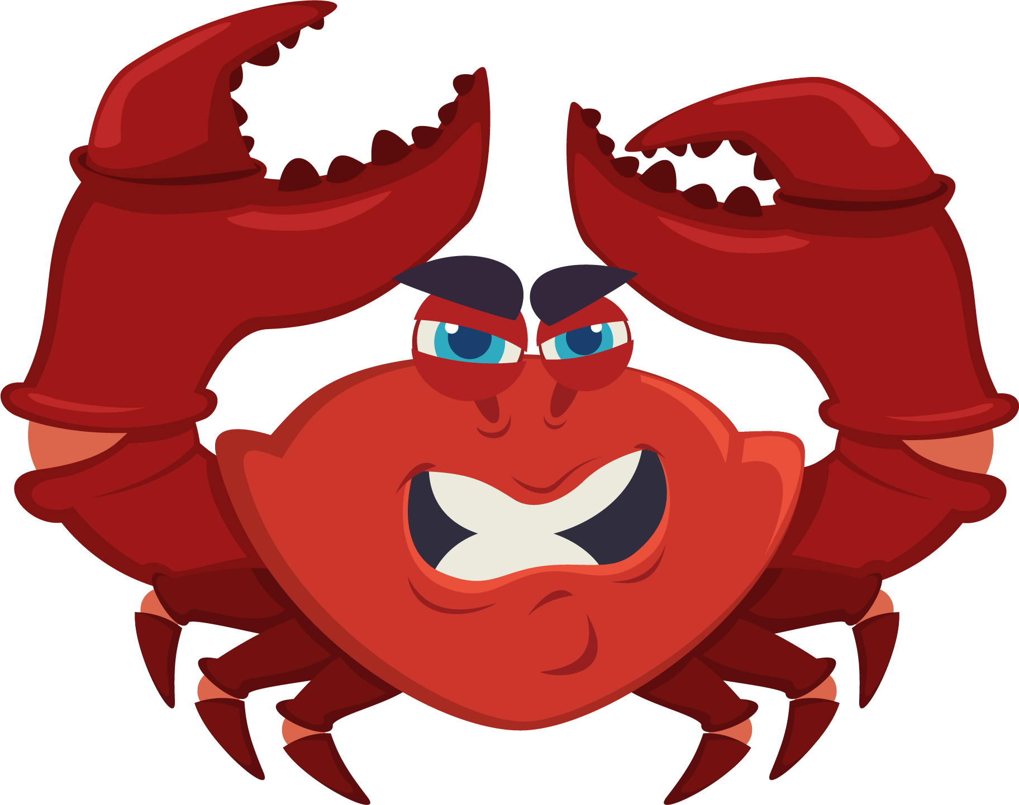
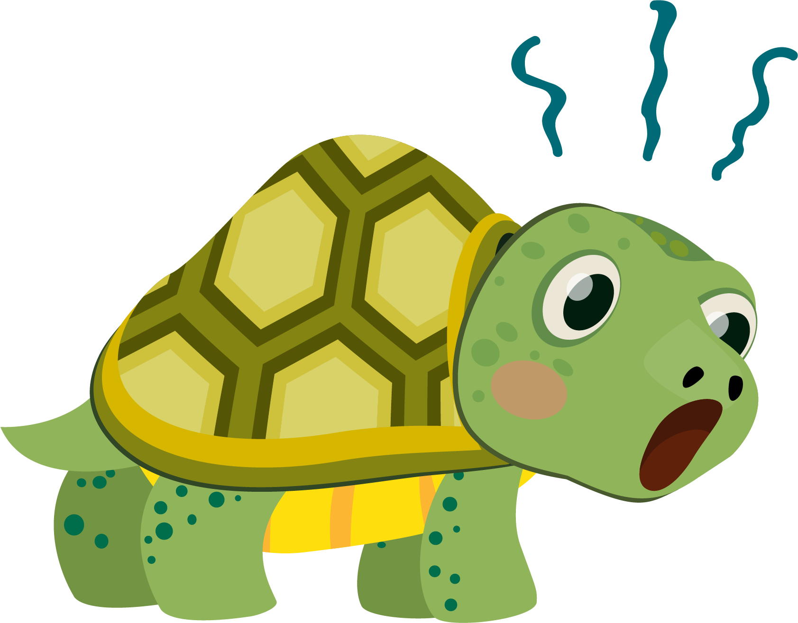
Lesson 6:
Turtle Crossing

Slide 2
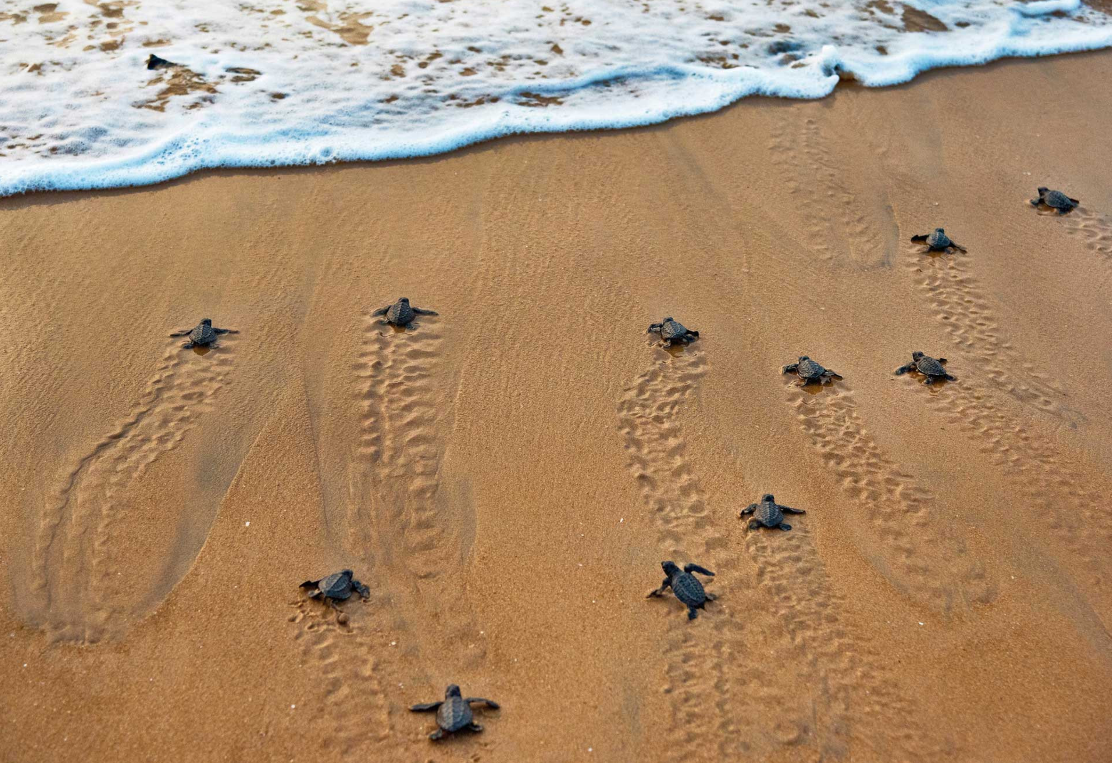
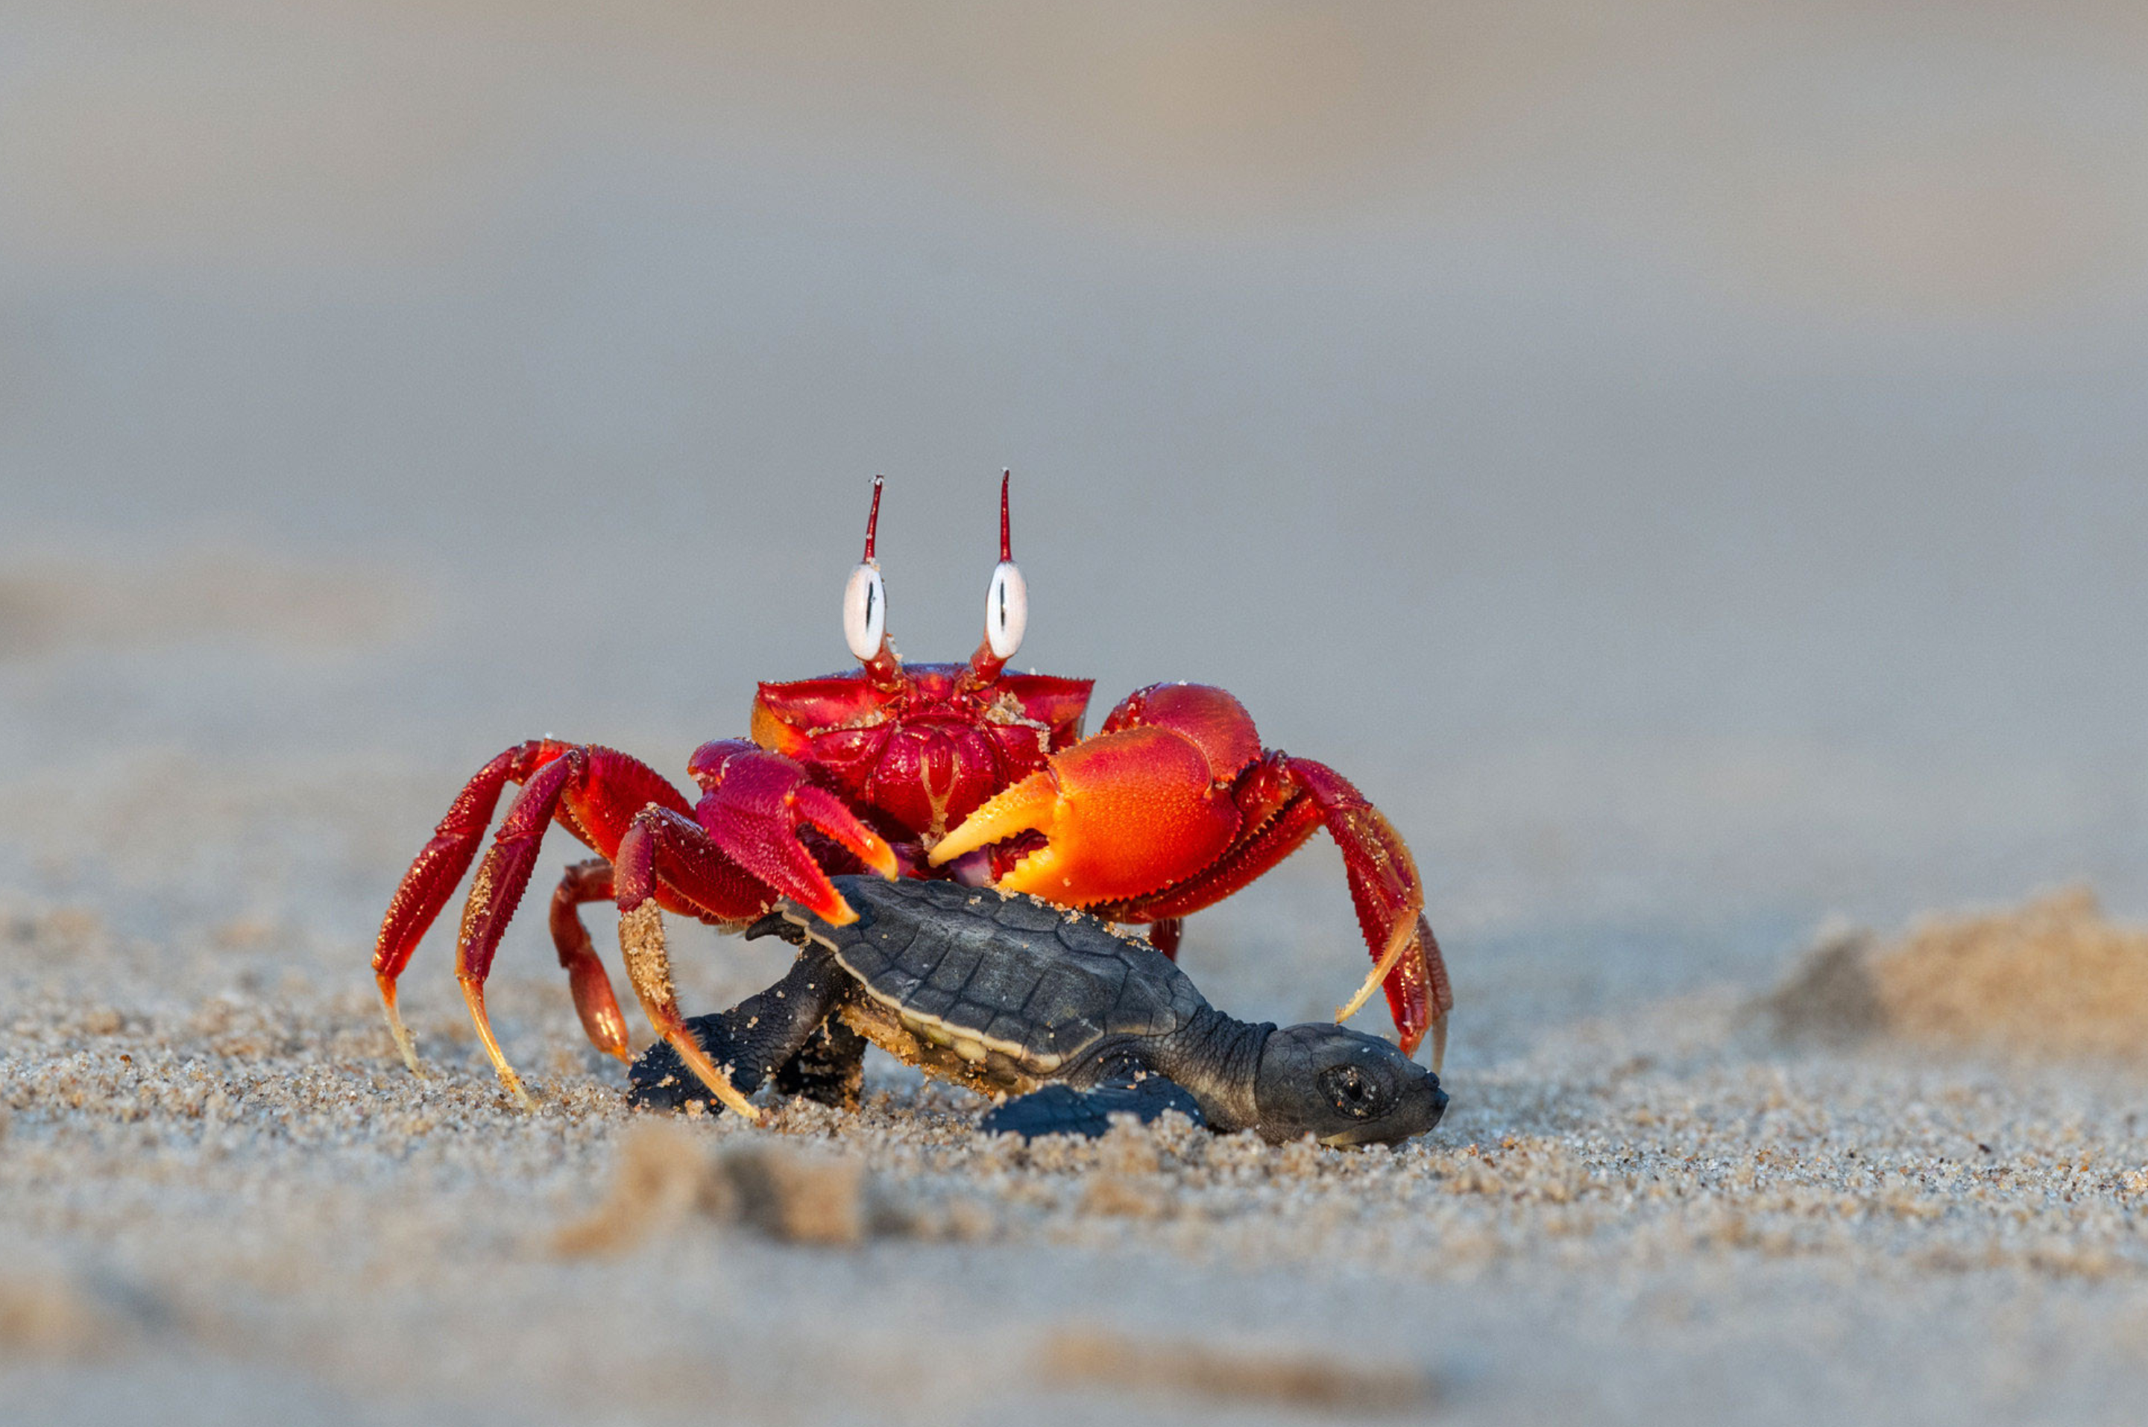
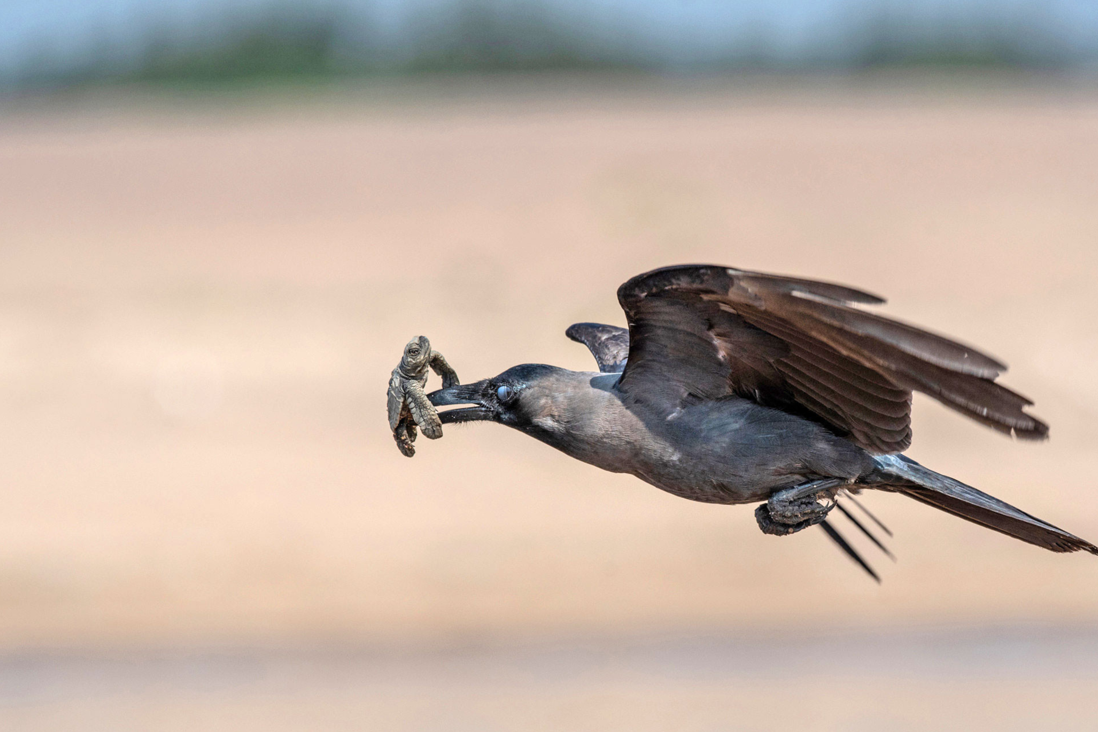
Dangerous Journey…

Slide 3
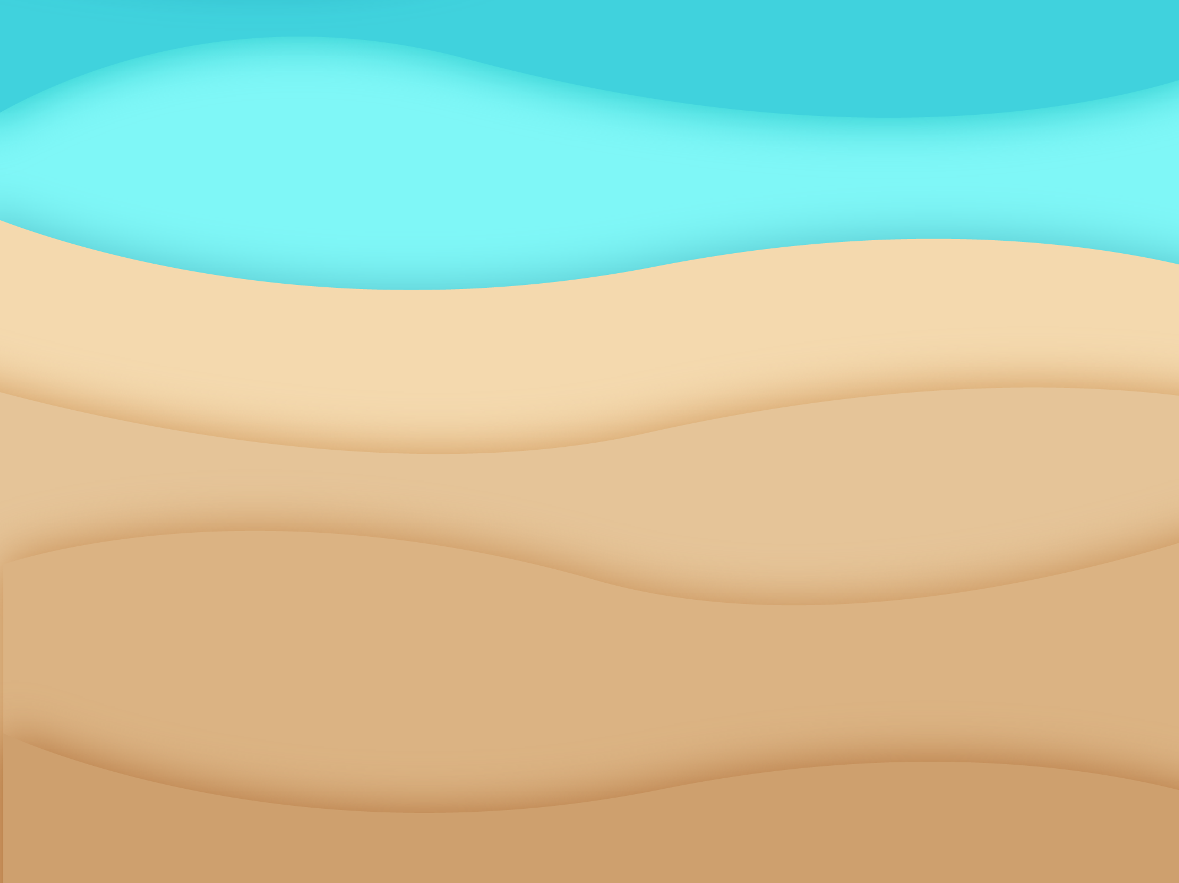
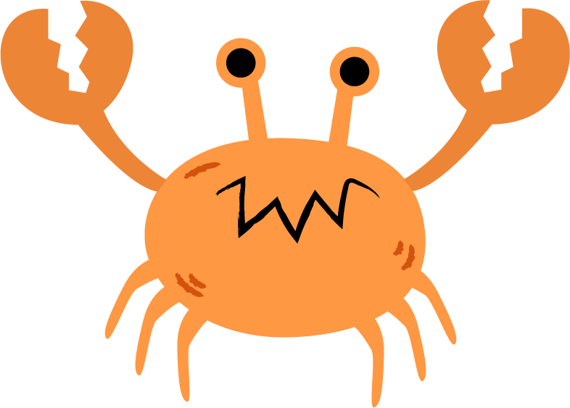
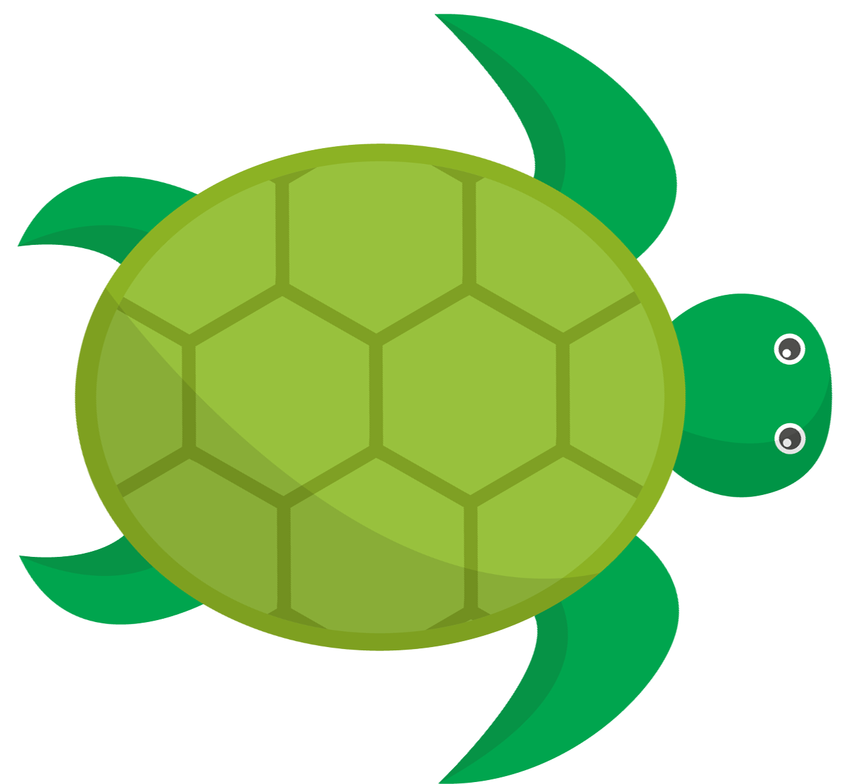
Turtle Crossing

Slide 4

Pick a Local Backdrop
Scratch for Newbies
Level1
Lesson 6 – Turtle Crossing
Resources
Backdrop
beach.png

Slide 5
Pick a Local Turtle
Scratch for Newbies
Level1
Lesson 6 – Turtle Crossing
Resources
Sprites
turtle.png

Slide 6
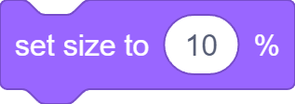

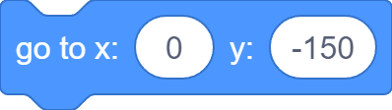
Set Turtle Up

Slide 7
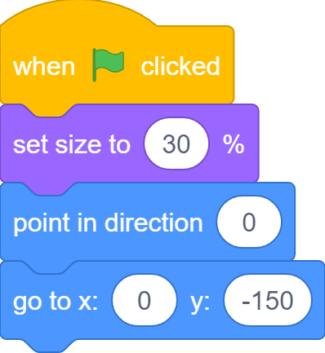
Set Turtle Up

Slide 8
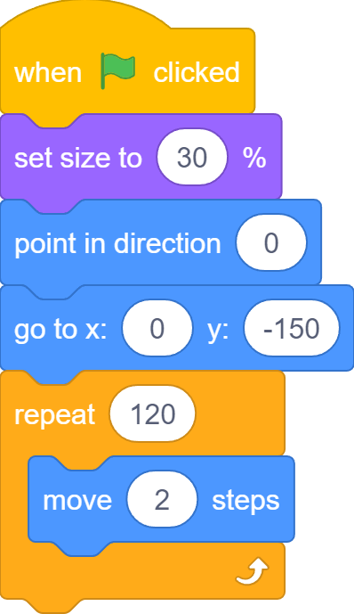
Move to Ocean

Slide 9
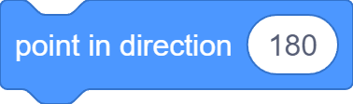
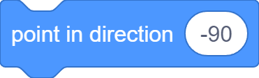
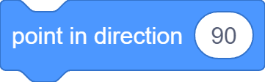
Change Turtle Direction

Slide 10

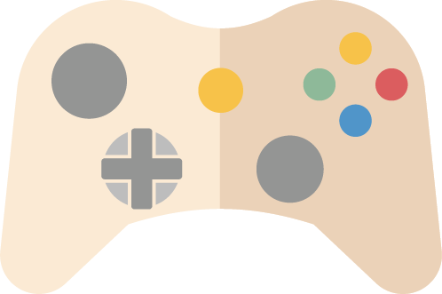

Game Controls

Slide 11




Control Turtle Direction

Slide 12
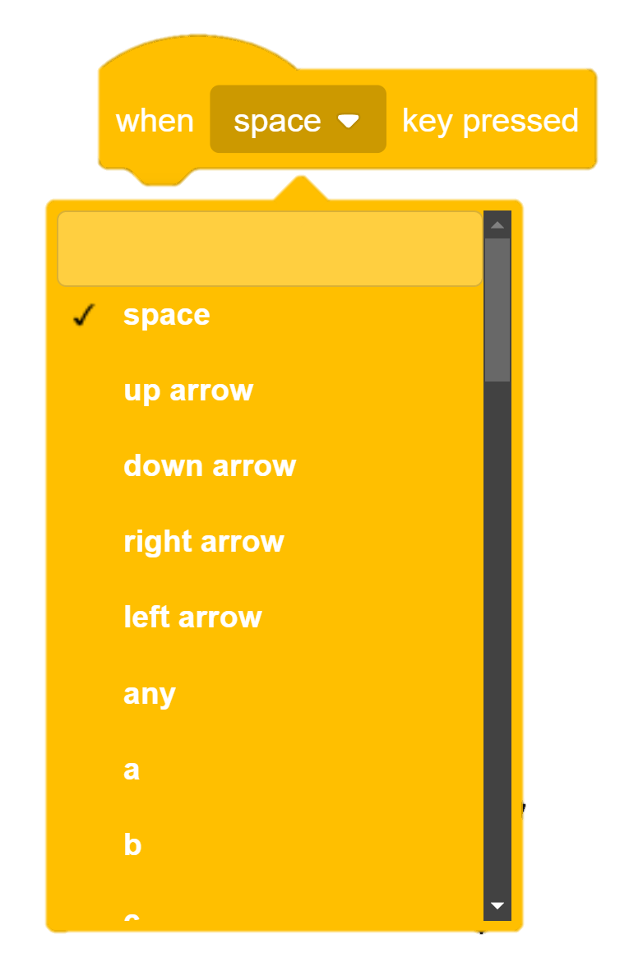
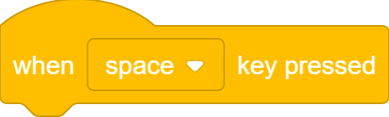
When Key Pressed…

Slide 13
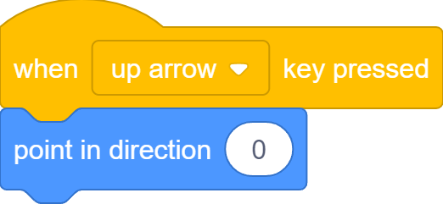
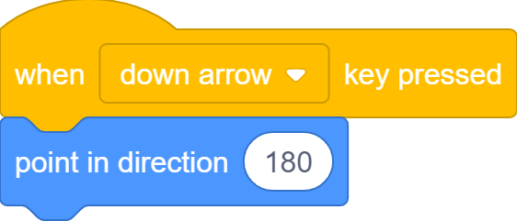

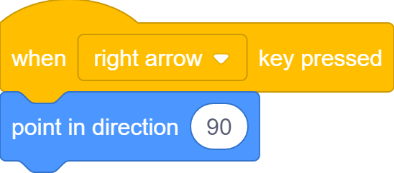
When Key Pressed…

Slide 14
Move to Ocean

Slide 15

Stop Somewhere
But sometimes, turtle stops before reaching the ocean…

Slide 16
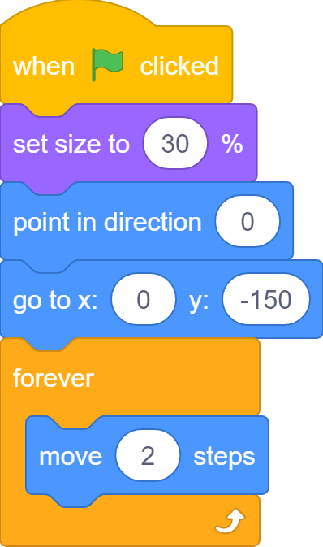
Move Forever

Slide 17
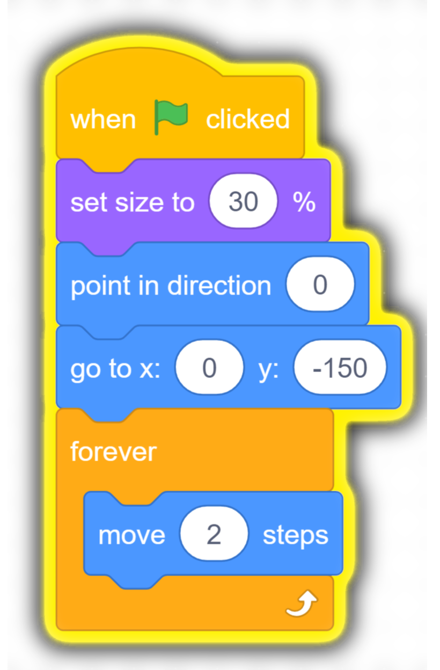
Move Forever
Turtle still moves after reaching ocean or hitting edge

Slide 18
Something In Between
We do not want to stop after moving some number of steps;
We do not want to move forever;
We want to stop after or move until reaching the ocean.

Slide 19
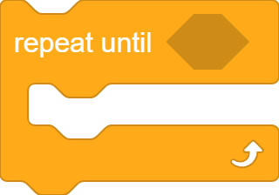
A third Type of Loop
It’s a loop
A hexagon slot for boolean blocks
Code blocks to repeat go inside

Slide 20











Boolean Blocks
Sensing
Operators

Slide 21
Boolean Blocks
Boolean blocks ask Yes or No questions. They are also called conditions that can be True (Yes) or False (No)

Slide 22
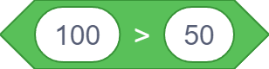
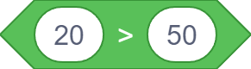
Boolean Blocks
Ture
False

Slide 23
Repeat Until…
If the condition is False, repeat
If the condition is True, jump out

Slide 24

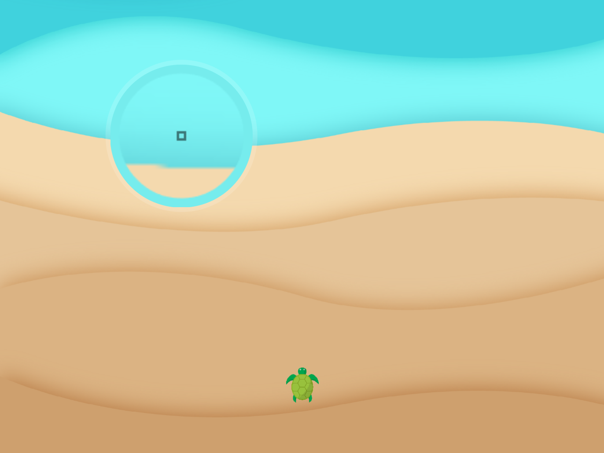
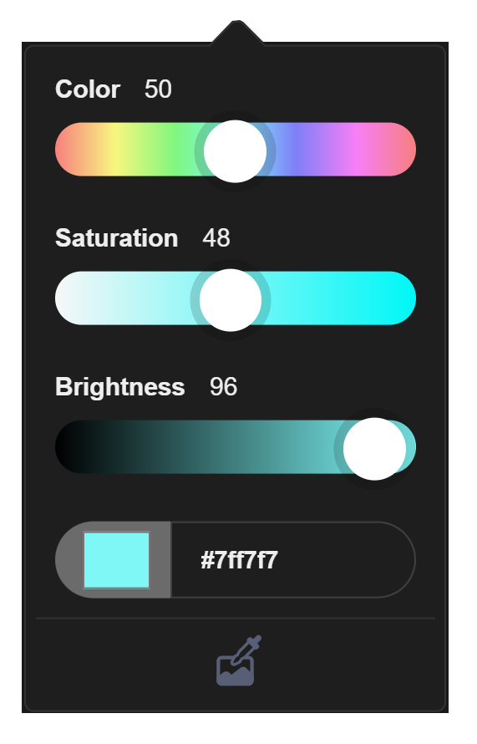
Reached Ocean?
Pick ocean color
Color Picker

Slide 25
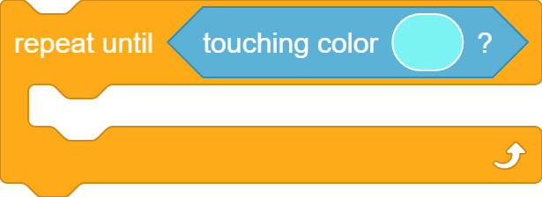
Repeat Until Reaching Ocean

Slide 26
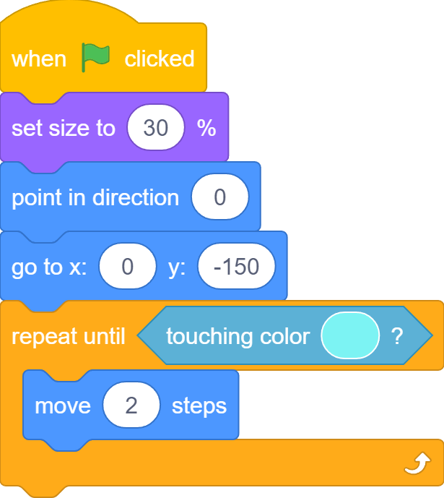
Repeat Until Reaching Ocean

Slide 27
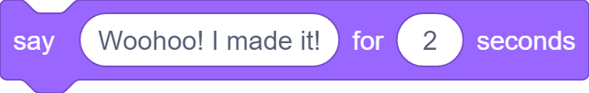
“Woohoo! I Made It!”

Slide 28
Pick a Local Crab
Scratch for Newbies
Level1
Lesson 6 – Turtle Crossing
Resources
Sprites
crab.png

Slide 29
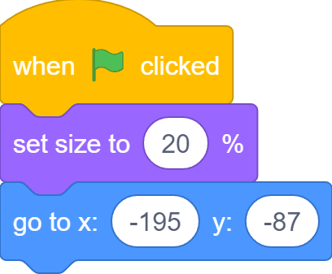
Set up Size and Position

Slide 30
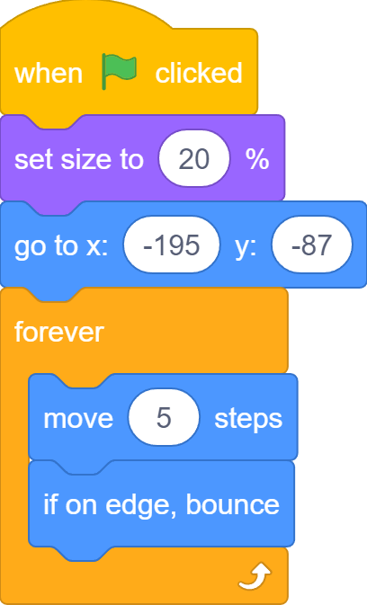
Move Sideway Forever

Slide 31

When Colliding…
Both turtle and crab continue to move after colliding…

Slide 32
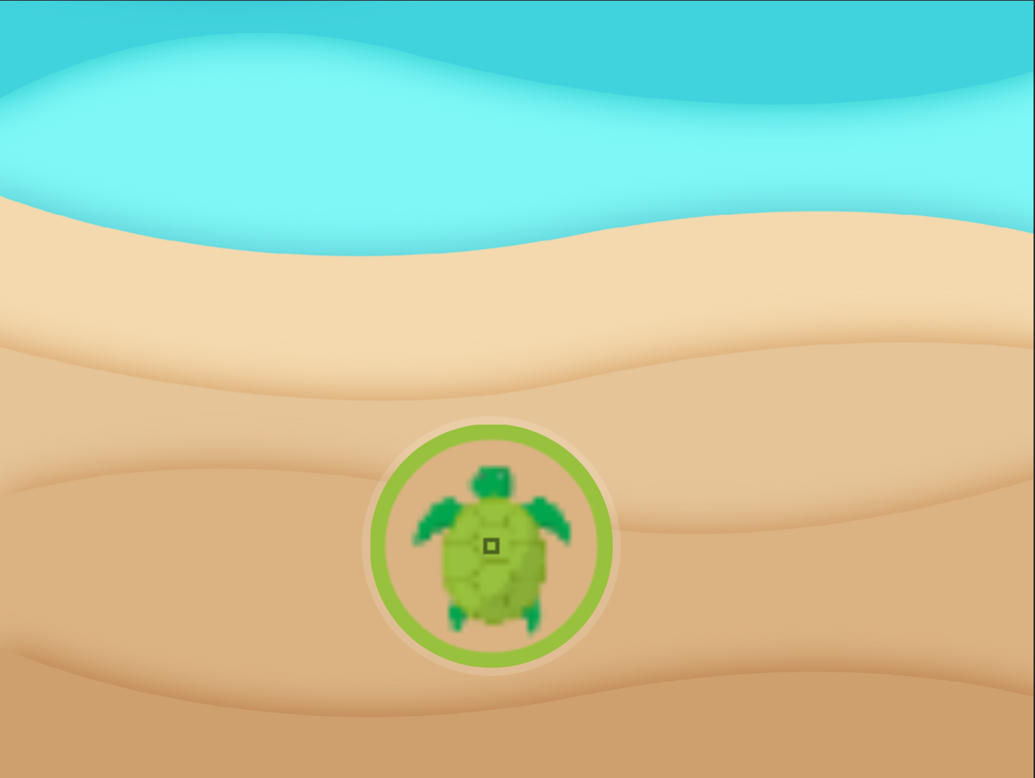

Is Crab Touching Turtle?

Slide 33
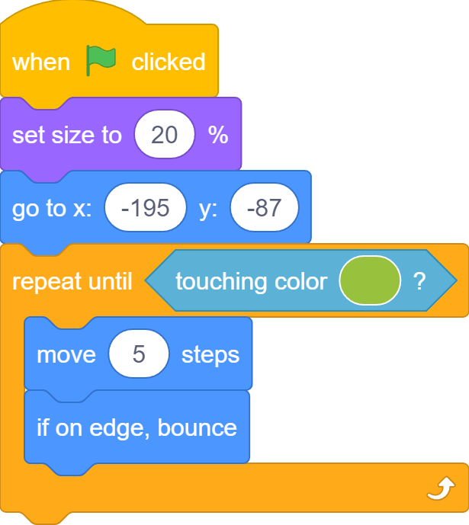
Stops When Touching Turtle

Slide 34
Stops When Touching Turtle
Crab stops moving as soon as it collides with the turtle

Slide 35
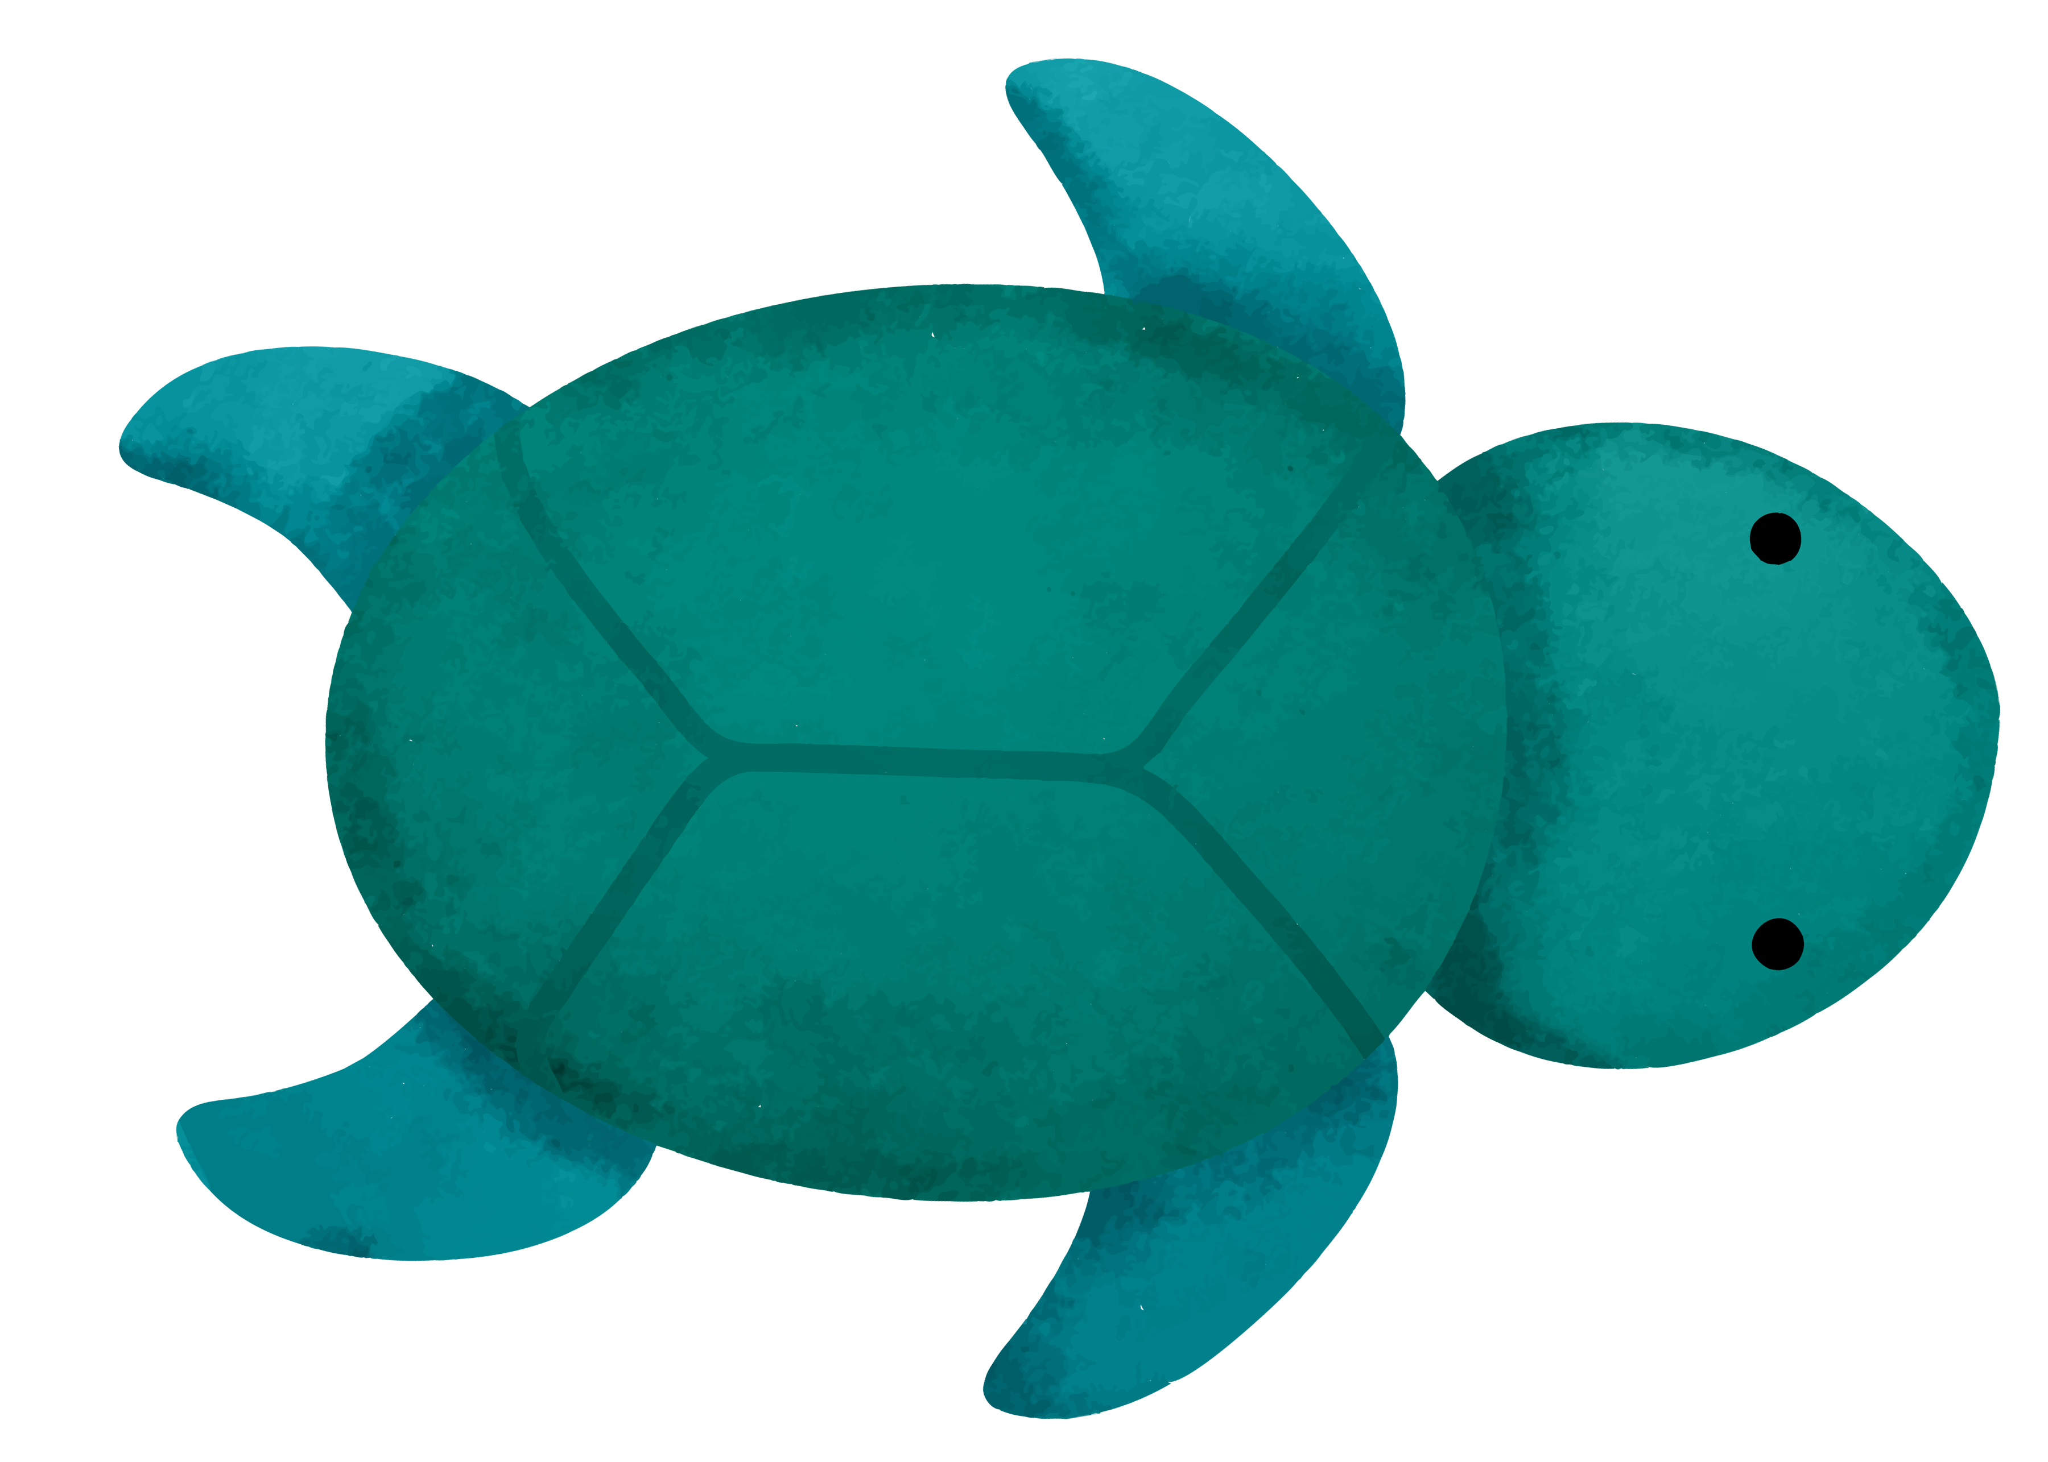
A New Turtle Costume

Slide 36
A New Turtle Costume
With a new costume, both turtle and crab continue to move again after colliding...

Slide 37
A New Turtle Costume
True
False

Slide 38
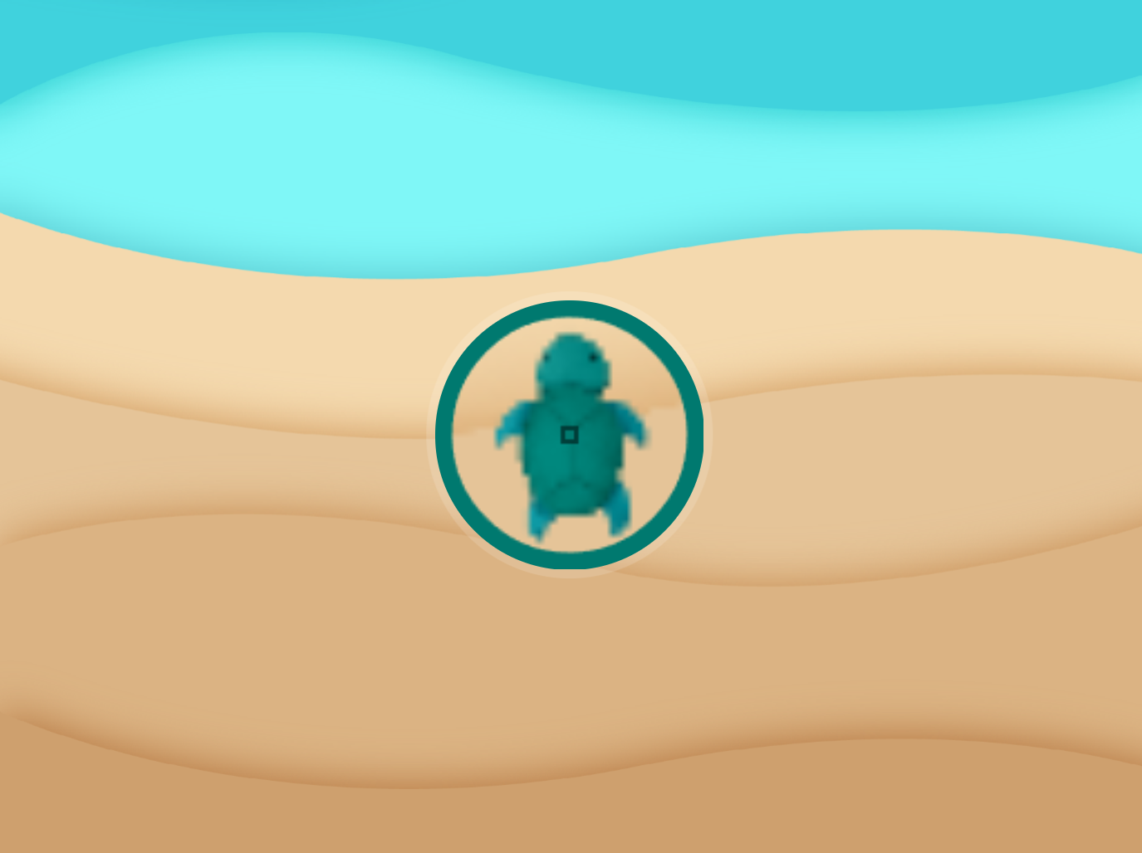

A New Turtle Costume

Slide 39
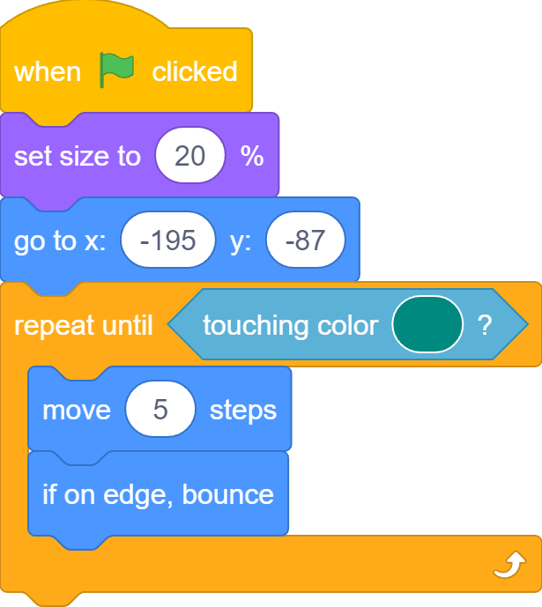
A New Turtle Costume

Slide 40
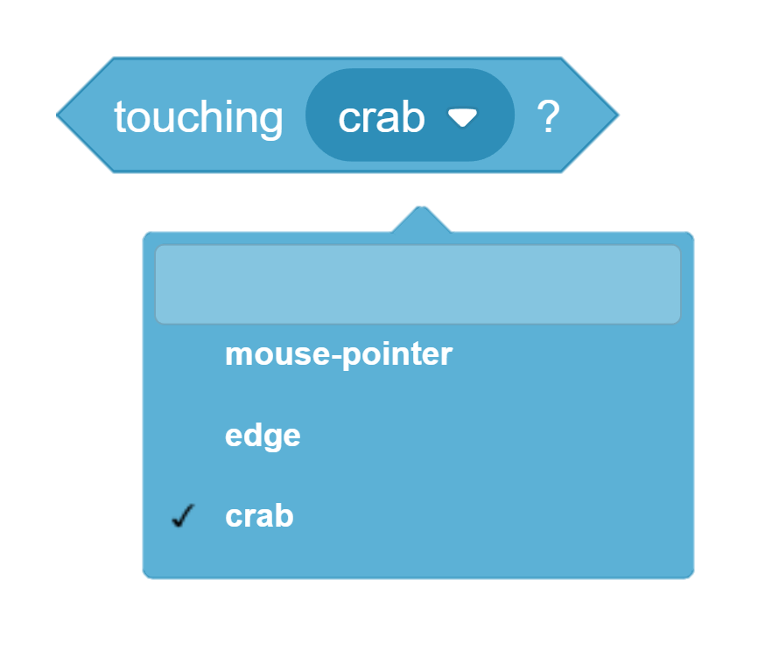
A Better Solution…

Slide 41
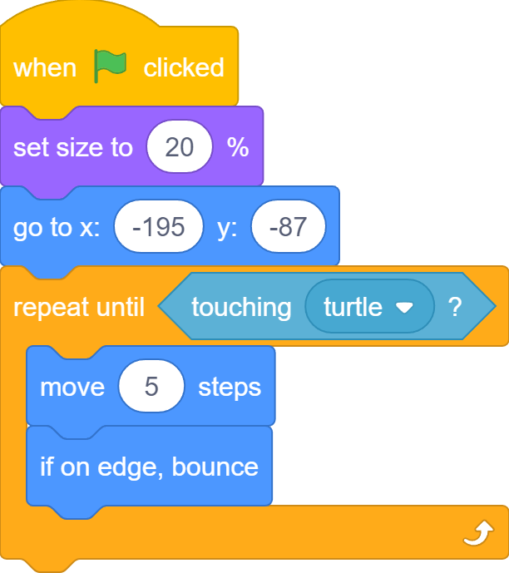
A Better Solution…

Slide 42
How to Stop Turtle?
Turtle continues to move after colliding with the crab…

Slide 43


We Can Stop Turtle
We can be the God and stop everything by clicking the STOP button, but…

Slide 44


The Game Should Stop Turtle
… the game should stop itself when it is game over!

Slide 45
The Crab is the God!
I know when I touch the turtle!

Slide 46

Stop All!
Stop all button, but We need to click it!
Stop all block, the Crab can do it!

Slide 47
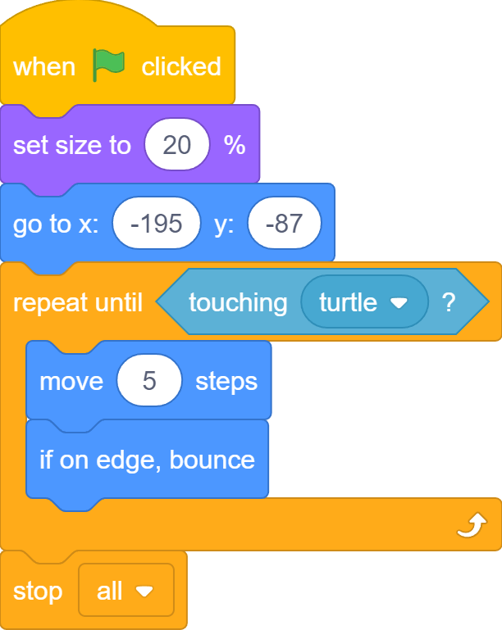
The Crab is the God!
I can stop the turtle and everything in the game!

Slide 48
How to Stop Turtle?
Nobody moves after a collision! Hooray!

Slide 49
What we learnt…
How to control game character with keyboard keys

Slide 50
What we learnt…
How to start scripts by pressing keyboard keys

Slide 51
What we learnt…
What are boolean blocks

Slide 52
What we learnt…
How to repeat until a Boolean block says “True” or “Yes”

Slide 53
What we learnt…
How to check is a sprite is touching a color on the stage

Slide 54
What we learnt…
How to check is a sprite is touching another sprite on the stage

Slide 55
What we learnt…
How to stop everything in a project

Slide 56
Exercises
Can you make the crab to start at a random x position?
Can you add sound effect when turtle reaches ocean?
Can you add sound effect when crab catches turtle?
Can you add more crabs?
Can you make crabs bounce around on the stage instead?
Can you stop all the crab when turtle reaches the ocean?

Slide 57
Exercises
Can you add a timer to time the turtle and make it say the out the time when it reaches the ocean?
Try using only the left the right arrow keys to control the turtle. This time the left arrow key is going to turn the turtle to the left a small number of degrees, e.g. 15 degrees. Similar, the right arrow is going to turn the turtle to the right a small number of degrees.

Slide 58
Thank you and see you in the next lesson!

